Slide 1

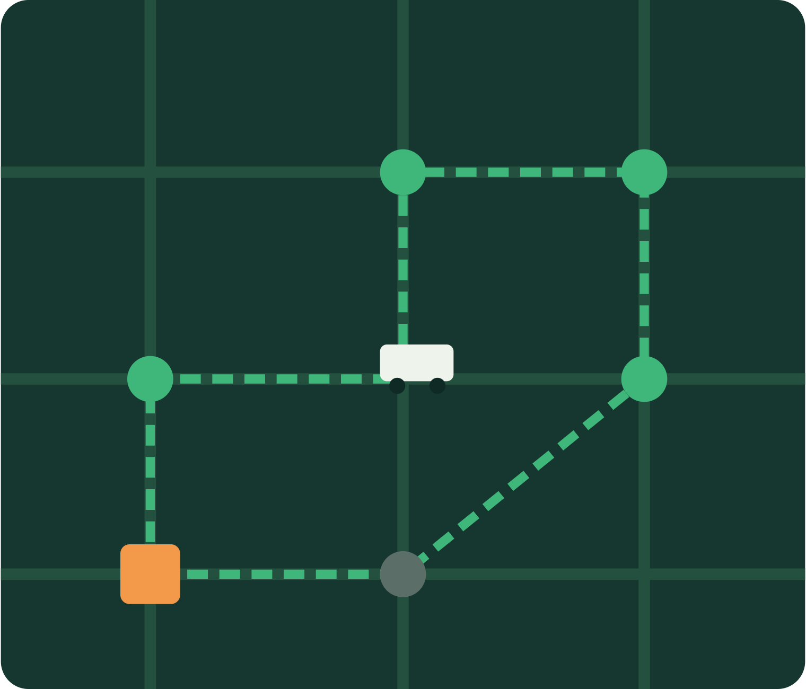
EcoRoute
DESIGN AND ANALYSIS OF ALGORITHMS · HACKATHON PROJECT
#31. Garbage Collection Route Optimizer
Algorithm-Driven Waste Collection Using Dijkstra, Greedy and TSP Optimization
EcoRoute dynamically selects garbage collection points and generates efficient vehicle routes while considering fill level, priority, vehicle capacity and travel distance.
Smart City · Waste Management · Route Optimization · Python + Streamlit
Team: Kadiyala Abhiram (25MVCSMR0311)
Mohammed Sayfulla (25MVCSMR0330)
Bollu Partha Saradhi (25MVCSMR0289)
K. Kanishk (25MVCSMR0319)

Slide 2
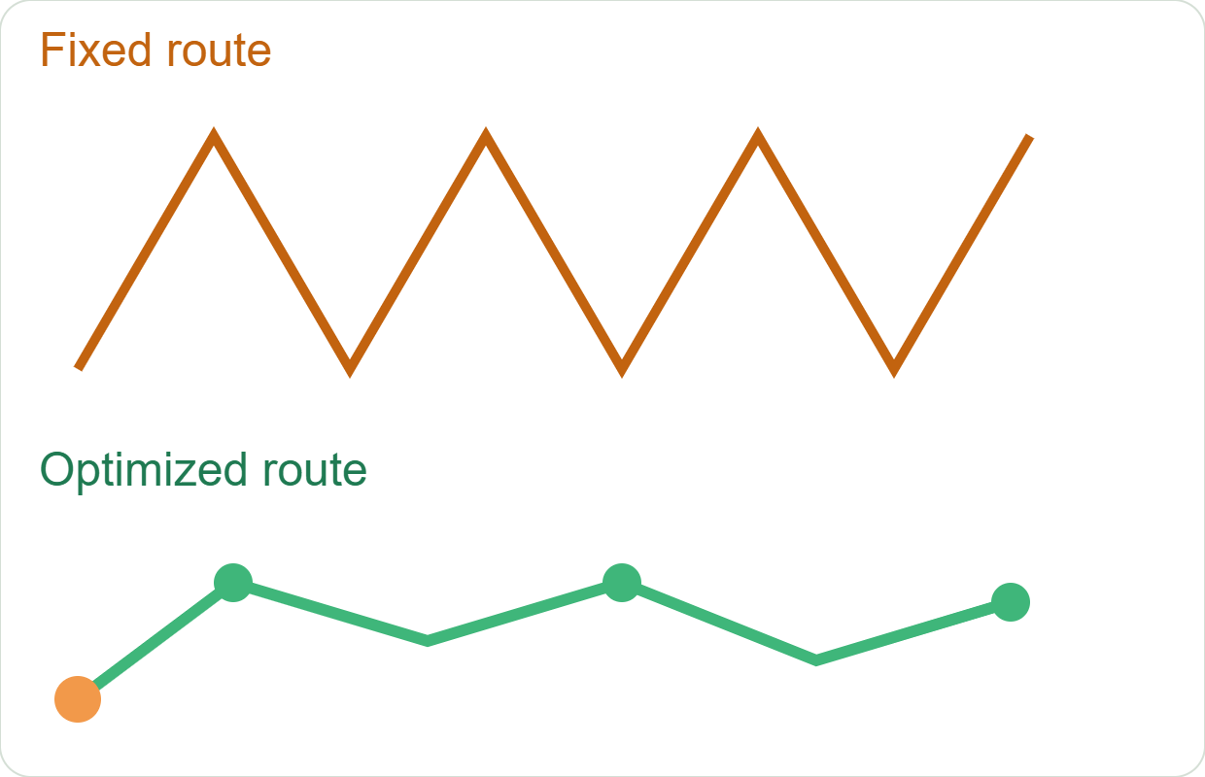
Problem Statement & Need
Fixed routes ignore reality
Resulting problems
Some bins are not full
Some bins are overflowing
Vehicles have limited capacity
Points have different priorities
Road conditions may change
Unnecessary travel distance
Higher fuel consumption
Increased operational cost
More CO₂ emissions
Delayed collection of critical bins
Main challenge: decide which bins to collect, in what order, by which vehicle, and when the vehicle returns to the depot.

Slide 3
Proposed Solution & Main Features
EcoRoute converts waste collection into a weighted graph optimization problem.
Garbage Points
Filtering
Shortest Paths
Route Selection
Route Improvement
Capacity Check
Optimized Route
Exact pickup placement via map clicks
Add/change depot location
Fill-level and priority-based selection
Editable pickup details
Multiple vehicles
Vehicle-capacity constraints
Dynamic route recalculation
Graph-edge road closure simulation
Real-road route visualization
FCFS vs Greedy vs Optimized comparison
Step-by-step algorithm execution
Smart alerts and scenario presets
Route analytics
Fuel and CO₂ estimation
SQLite route history
CSV and PDF reports

Slide 4
Algorithms & System Workflow
1 · Input Locations
2 · Weighted Graph
3 · Dijkstra Paths
4 · Greedy Route
5 · TSP / 2-opt
6 · Capacity Check
7 · Multi-Vehicle
8 · Optimized Route
Dijkstra
Greedy
TSP / 2-opt
Shortest path between graph nodes. Road links are non-negative weighted edges.
Picks the next point by distance, fill level and priority. Fast initial feasible route.
Swaps inefficient edge pairs to improve the greedy route. Exact TSP is too costly, so a heuristic is used.
O(n²)
O((V + E) log V)
≈ O(n²) per pass

Slide 5
Streamlit Technology & Architecture
Layer | Technology
Frontend / UI | Streamlit, Folium, streamlit-folium
Backend / Logic | Python
Database | SQLite
Data handling | Pandas
Map | OpenStreetMap
Road geometry | OSRM
Reporting | ReportLab, CSV export
User
Streamlit Interface
Python Optimization Engine
Dijkstra + Greedy + 2-opt
SQLite Database
OSRM / OpenStreetMap
Interactive Route Output
Our DAA algorithms decide which points are visited and in what order. OSRM only projects the already-optimized route onto real drivable roads.
Core optimization runs locally; internet is needed only for map tiles and road geometry.

Slide 6
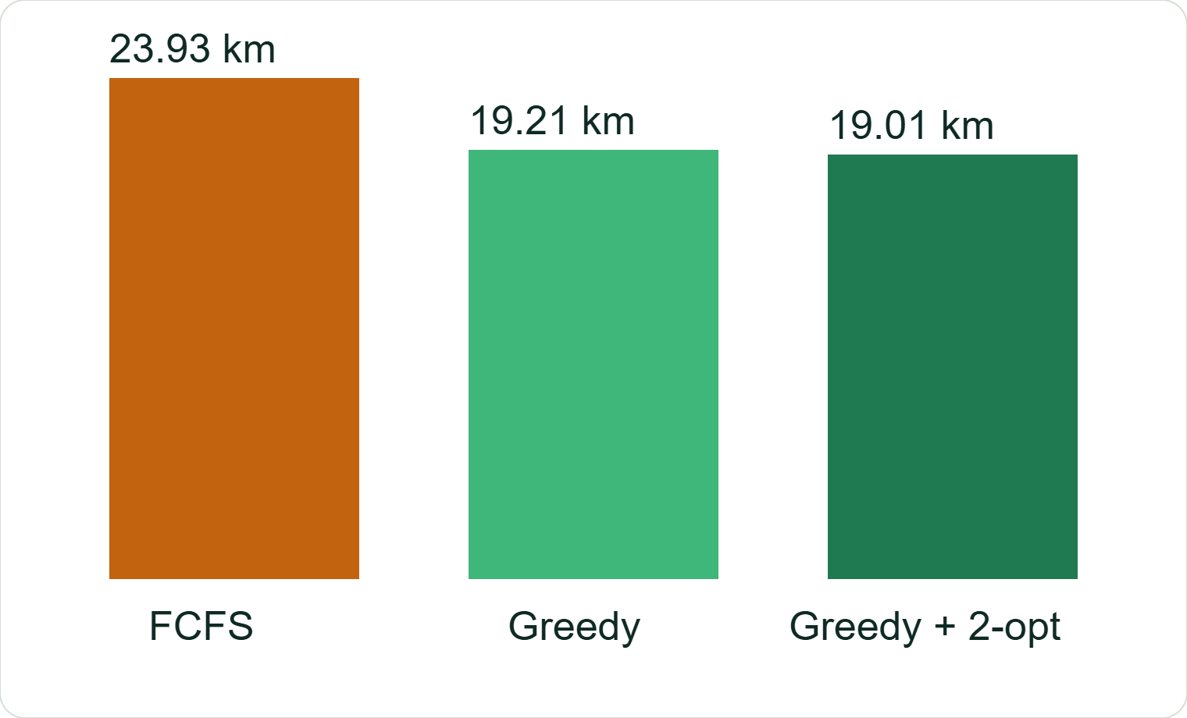
Results, Demo & Performance
≈ 20.6%
shorter than FCFS in the sample scenario
Also reported: total collected waste · skipped bins · trips · vehicle utilization · fuel usage · CO₂ emissions · real-road ETA [values from demo run]
The optimized approach cuts unnecessary travel while still serving high-priority, high-fill points.

Slide 7
Future Scope & Conclusion
Achieved
Next
Complete Streamlit application
Map-based pickup selection
Dynamic, multi-vehicle routing
Capacity handling
DAA algorithm comparison
Analytics, reports, route history
Road closure simulation
IoT smart bins, live fill sensors
GPS truck tracking, live traffic
Automatic daily route generation
Municipal control dashboard
AI/ML garbage prediction
Dynamic fleet management
Full CVRP, city-scale deployment
Smart Bin Sensors
Central Server
Optimization Engine
Municipal Fleet
Live Route

